Slide 1


OTP Sender
Prepared By:
Heet Pambhar (18DIT040)

Slide 2
Introduction
This project will help you to generate N length of OTP using Python.
Here you can use any webservices for sending sms, I have used Fast4sms.
It is very easy to generate the OTP but the tedious task is to send that OTP to users automatically.
In this project I have made it easier for the users to send bulk sms.

Slide 3
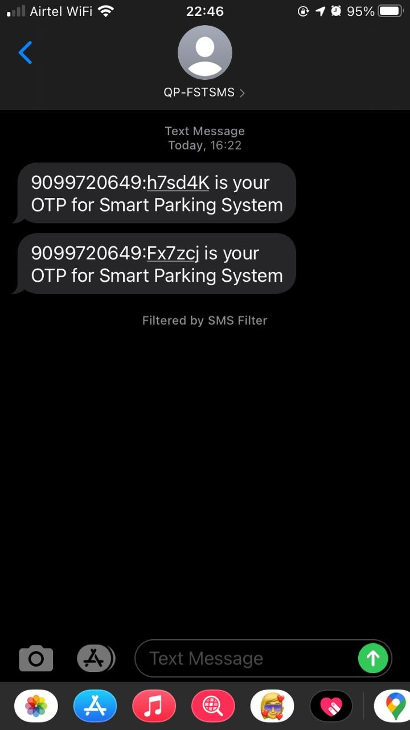
Implementation

Slide 4
Conclusion
In this project, I have learned the usage of basic python function like Math, Random, Json, etc. I have also learned the usage and modification of API.

Slide 5
References
https://www.fast2sms.com/dashboard/sms/bulk
https://www.fast2sms.com/dashboard/dev-api
https://docs.fast2sms.com/

Slide 6

Prepared By:-
Thank You.
HEET PAMBHAR (18DIT040)

